Slide 1


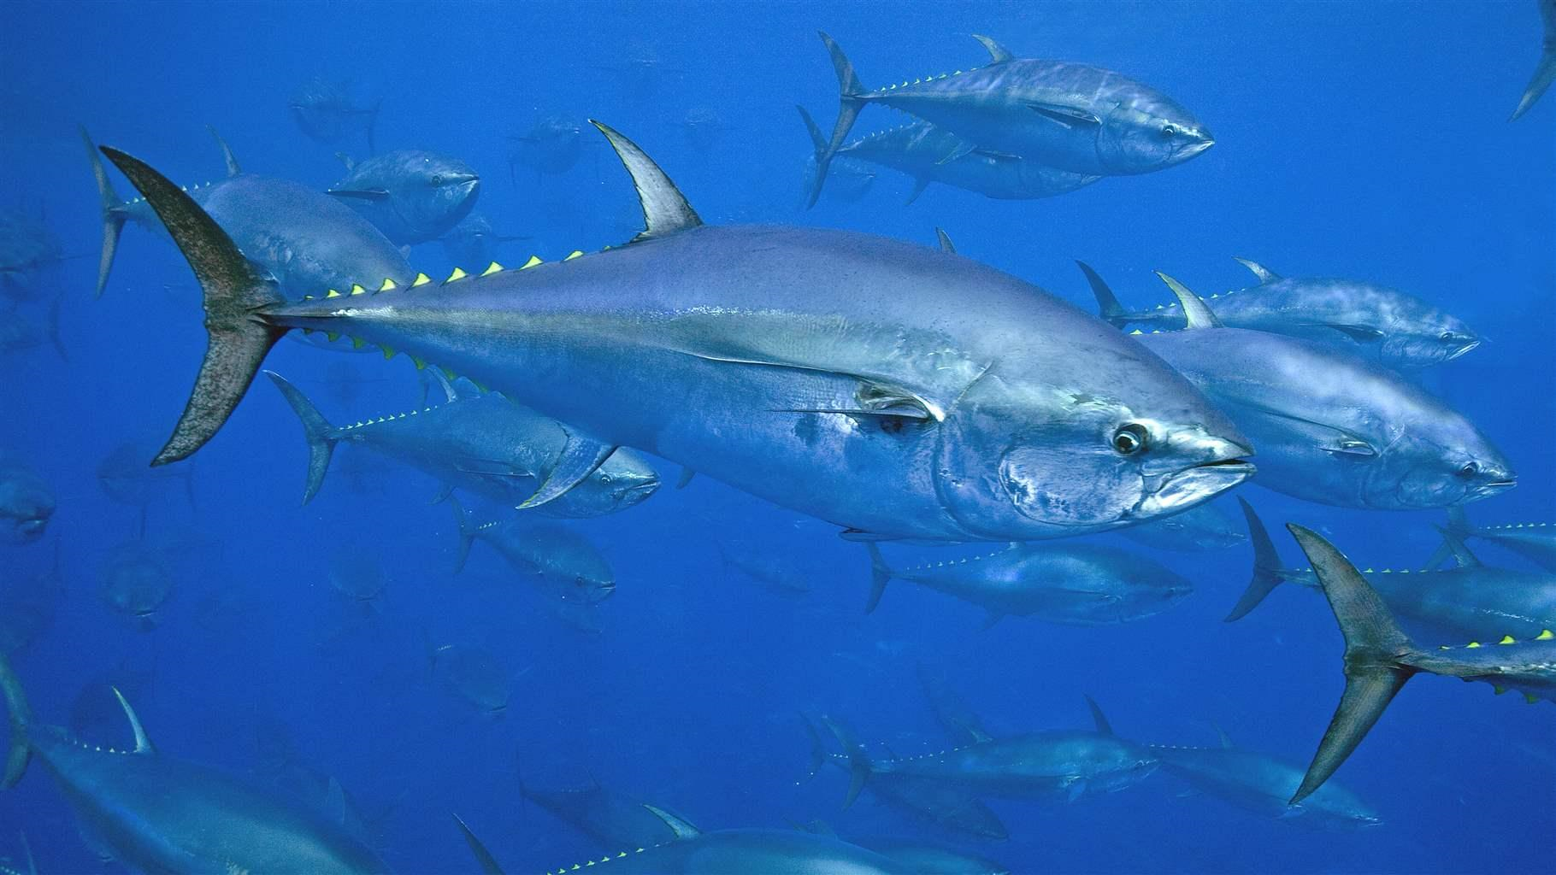
SCRS Report 2019
Panel 2
Albacore Tuna
Bigeye
Yellowfin
Bluefin Tuna
Skipjack

Slide 2

Summary Northern Temperate Tunas
Presentation Summary
  State of Stocks and Outlook (from Executive Summaries)
    North Albacore
    Eastern Bluefin tuna
    Western Bluefin tuna
  Effects of Current regulations (from Executive Summaries)
  Management recommendations(from Executive Summaries)
  Recommendations with financial implications
  Responses to the Commission
  Workplan

Slide 3
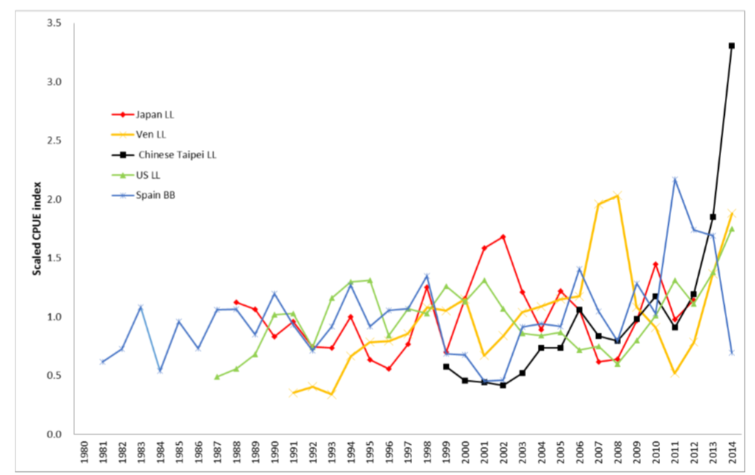
Fishery Indicators – Albacore North Atlantic
No assessment, last assessment 2016 with data up to 2014.
Fishery indicators (2019):
  Catch Updated to 2018
  Abundance indices not updated
  Mean weights not updated
Biological work under the North Atlantic Research Program.
North Atlantic

Slide 4
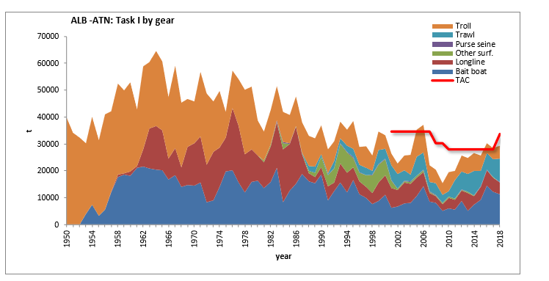
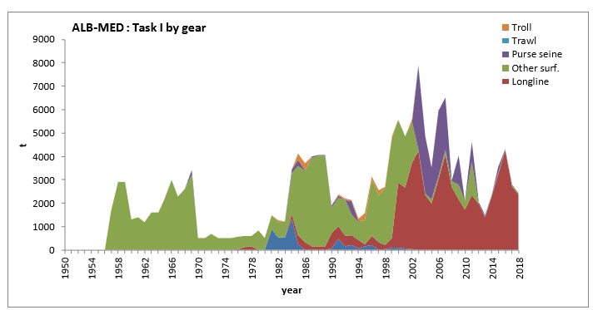
State of the stock - Albacore
Total albacore catches by gear type for the north Atlantic and the Med stocks to 2018.
- North Atlantic Catches did not exceeded TAC (33,600t for 2018-2020) in 2018.
- Albacore catches generally declined from the 1960’s to 2008.
- Since 2008 ALB catches in north have been increasing
- Catches in MED have been decreasing since 2016.
There has also been a change to predominately longline in 2012 in the MED.

Slide 5
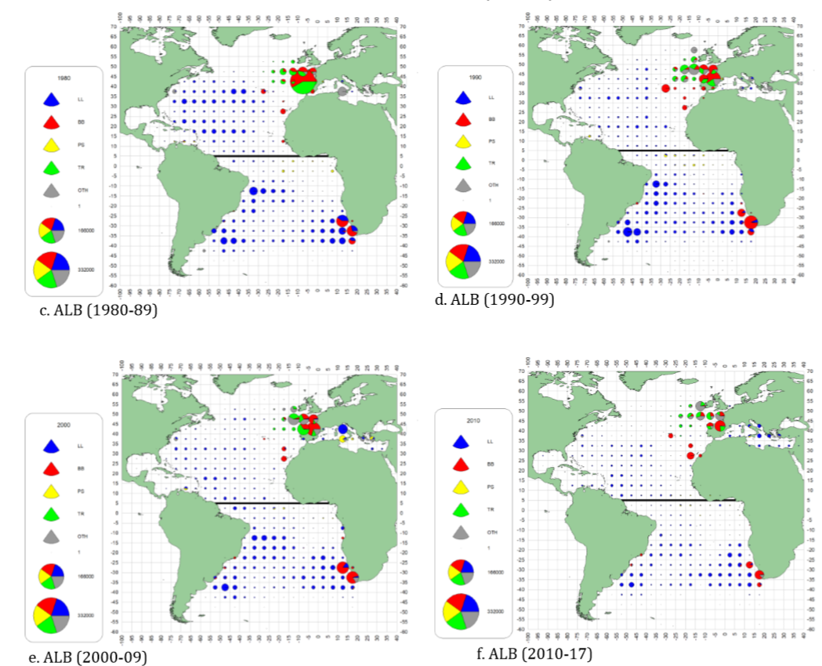
Fishery Indicators - Albacore
Geographic distribution of albacore accumulated catch by major gears and decade (1980 - 2017).

Slide 6
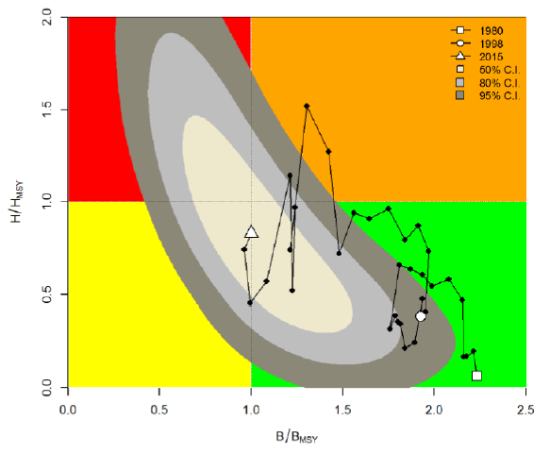
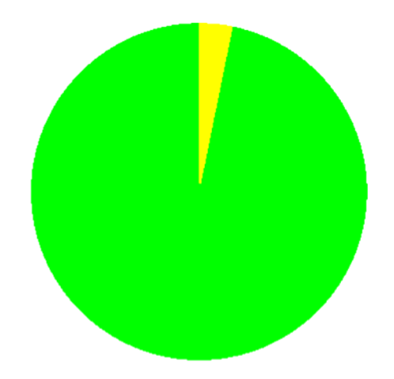
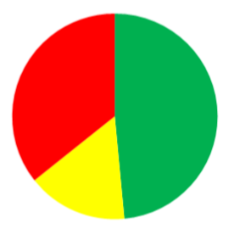
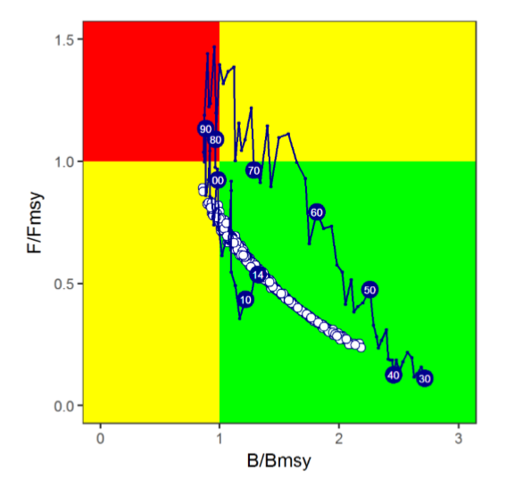
State of the Stock- Albacore
Mediterranean
North Atlantic
North Atlantic
3.2%
36.0%
48.0%
96.8%
16.0%
neither overfished nor overfishing
overfished or overfishing
probability of being overfished and overfishing

Slide 7
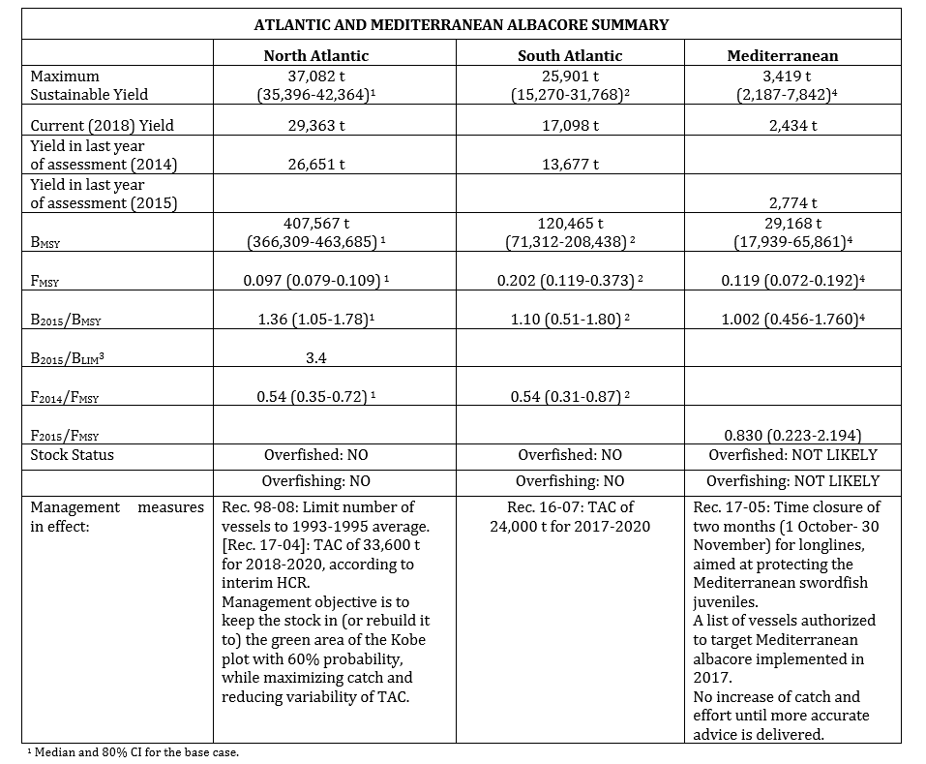
Management Recommendations - Albacore
North - An external peer review confirmed that the MSE framework appears to be scientifically sound and robust to uncertainty. Thus, the adopted interim HCR that led to a TAC of 33,600 t had a robust scientific basis.
MED - There is considerable uncertainty about current stock status. Recommendation to maintain catches below MSY.

Slide 8
Albacore - MSE
Interim Harvest Control Rule (HCR) for North Atlantic albacore used to set catch limits for the period 2018-2020.
In 2018, the code and algorithms used within the North Atlantic albacore MSE were reviewed to verify that the simulations were run as expected(Scully, 2018, SCRS/2018/142).
the MSE was found to be of high quality and robust to uncertainty.
A series of recommendations to improve the MSE framework were provided and addressed in 2019 as follows.
  Consolidated report requested in 17-04
  Method description
  2018 results regarding the performance of the adopted HCR and alternatives were updated with the new code
  Alternative HCR with TAC “20% down – 25% up” were examined.
  Clarification and correction of tested run.

Slide 9
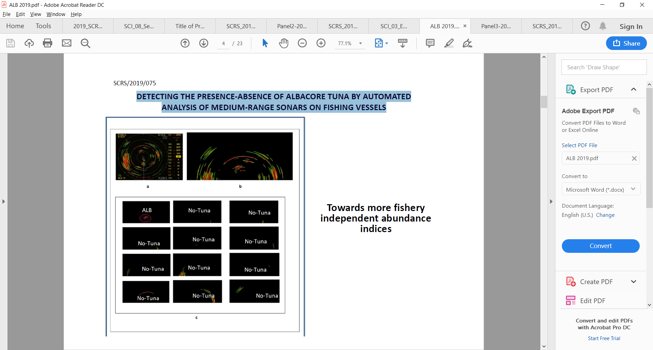
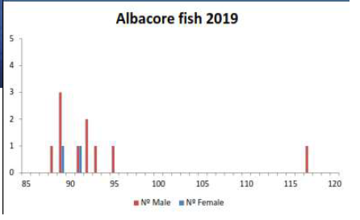
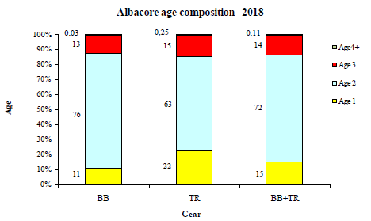
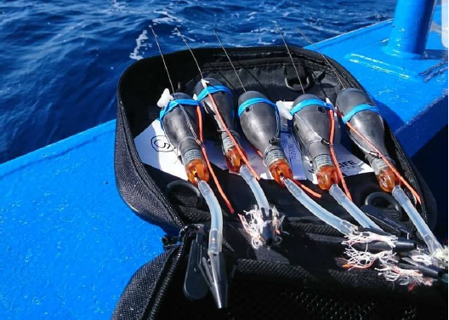
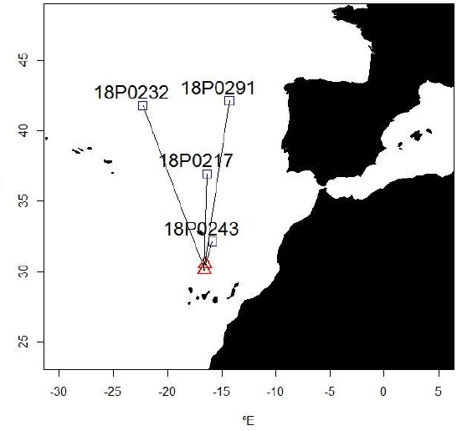
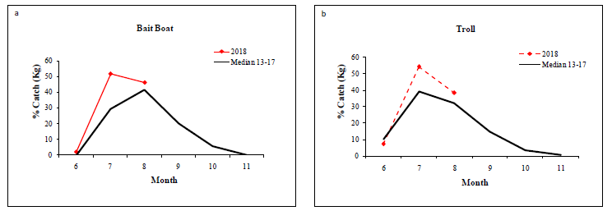
New Information from Albacore Research
Fishery Independent Indices: Detecting the presence- absence of Albacore tuna by medium-range commercial fishing sonar
Albacore gonad sampling in the Canary Islands
Spanish fisheries update
North Atlantic albacore pop-up tagging in the
Canary Islands
4 tags, 151 days of info

Slide 10
ALB N Responses to the Commission
No Responses to the Commission were required specifically for North Atlantic or the Mediterranean Albacore stocks in 2019.

Slide 11
North Atlantic ALB Workplan 2020
North Atlantic Stock Proposed Work Plan (Details Appendix 13)
Focus on Stock Assessment.
  Update the surplus production model used in the 2016 assessment, with data up to 2018.
  Prepare catch summaries (T1) and mean weights per fishery and year.
  Update CPUE indices for • Japanese longline • Chinese Taipei longline • US longline • Venezuela longline • Spanish baitboat
  Evaluate the indices against the standards provided by the WGSAM.
Implement a 4-year comprehensive Research Programme – with the main research objectives of:
1. Improved knowledge of the biology and ecology;
2. Improved monitoring of stock status;
3. Development of Management Strategy Evaluation framework.

Slide 12
ALB Workplan 2020
Mediterranean Albacore Stock Work Plan:
The main research objectives for 2020:
1. Improved knowledge of the biology (reproduction, growth and age) and ecology;
2. Improved monitoring of stock status, including update of the CPUE series used in the assessment (EU Spain LL, EU-Italy LL, Balearic larval survey) to confirm recent stock trends;
3. Explore alternative stock assessment methods suitable for data poor stocks.

Slide 13
ALB Recommendations with Financial Implocations
The Committee recommends continued funding of the albacore research program for North Atlantic albacore. The research will be focused on three main research areas: biology and ecology, monitoring of stock status, and management strategy evaluation. The requested funds is estimated at €842,000 for a 4-year work plan, with a cost of €70,000 for top priority tasks (reproductive biology and electronic tagging) to be executed in 2020.
In 2020, stock assessments of two albacore stocks (North Atlantic and South Atlantic) are planned. During the last years, the albacore species group experienced poor attendance from some CPCs directly involved in the fishery. The stock assessments that are planned to be conducted in 2020 will require external expertise on surplus production models (both Bayesian and non-Bayesian) to conduct the analyses.

Slide 14
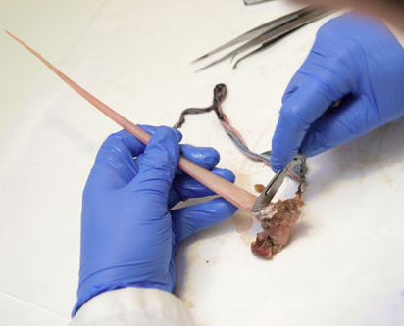
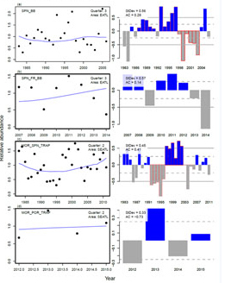
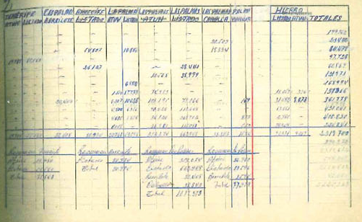

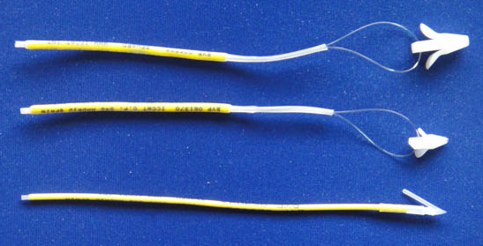
GBYP Program - Structured in six main lines of activity
Biological studies
Coordination
Modelling
Data recovery
Fishery independent
indices
Tagging

Slide 15
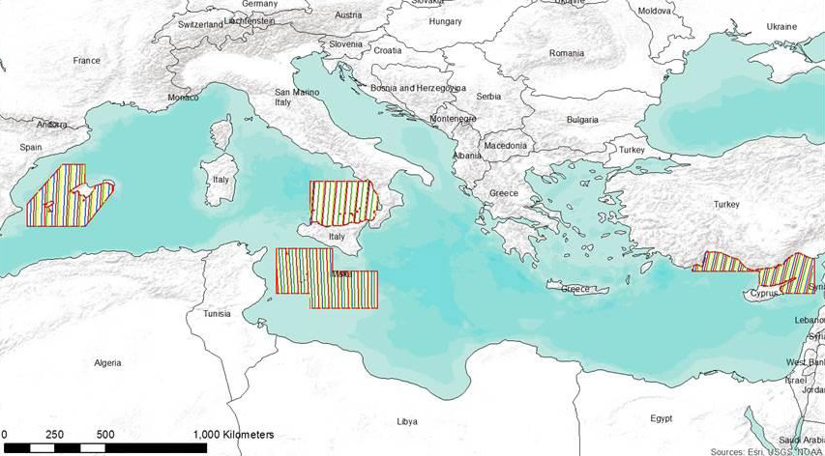
Aerial survey: Independent indices:
Research Programs - GBYP
Biological Studies/Sampling
GBYP tissue bank
Collecting tissue samples and otoliths - maintained by AZTI
Population structure and mixing
Otolith microchemistry
Genetic analysis (SNPs)
AGE-Length Key (ALK)
Ageing – otolith reading
Improvements in ageing methodology
Growth and reproductive parameters
BFT reproduction workshop (SCRS/2019/180)
Workshop on BFT Growth (SCRS/2019/132 and 144)
Growth rates in farming facilities
Growth in farms study (5 farms) (SCRS/2019/198)
Standard sampling strategy established in 2017
surveys conducted on the 4 main spawning areas
Time series available: 2010, 2011, 2013, 2015, 2017, 2018, 2019

Slide 16
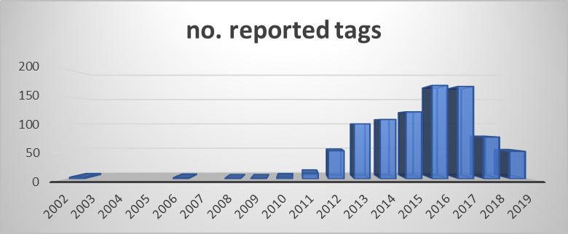
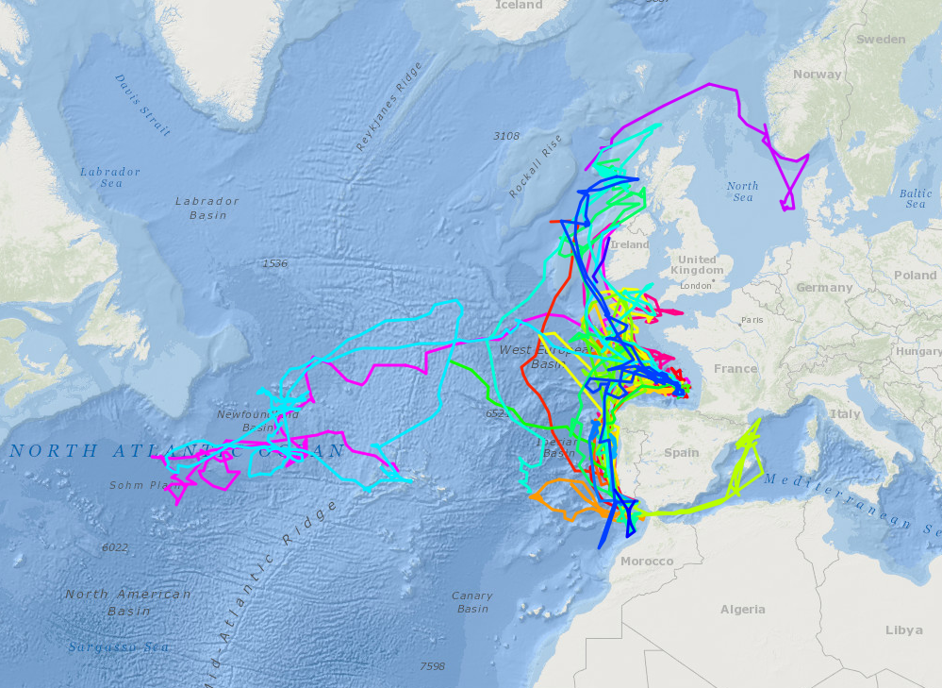
Tagging
Research Programs - GBYP
Continuation conventional tagging carried out by CPCs.
Electronic tagging objectives 2018-2019:
  Estimate the degree of mixing of western and eastern bluefin tuna stocks along the different statistical areas (MSE needs)
  42 electronic tags deployed in 2018 (30 off Portugal, 10 off Ireland, 2 off Norway).
  37 electronic tags to be deployed in 2019 (7 off Portugal, 15 off Ireland, 15 Skagerrak)
Workshop on e-tags deployment methodology

Slide 17
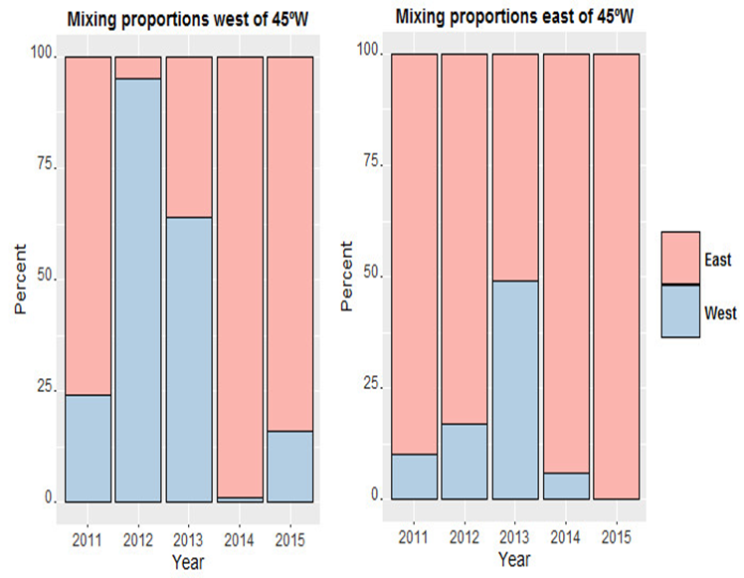
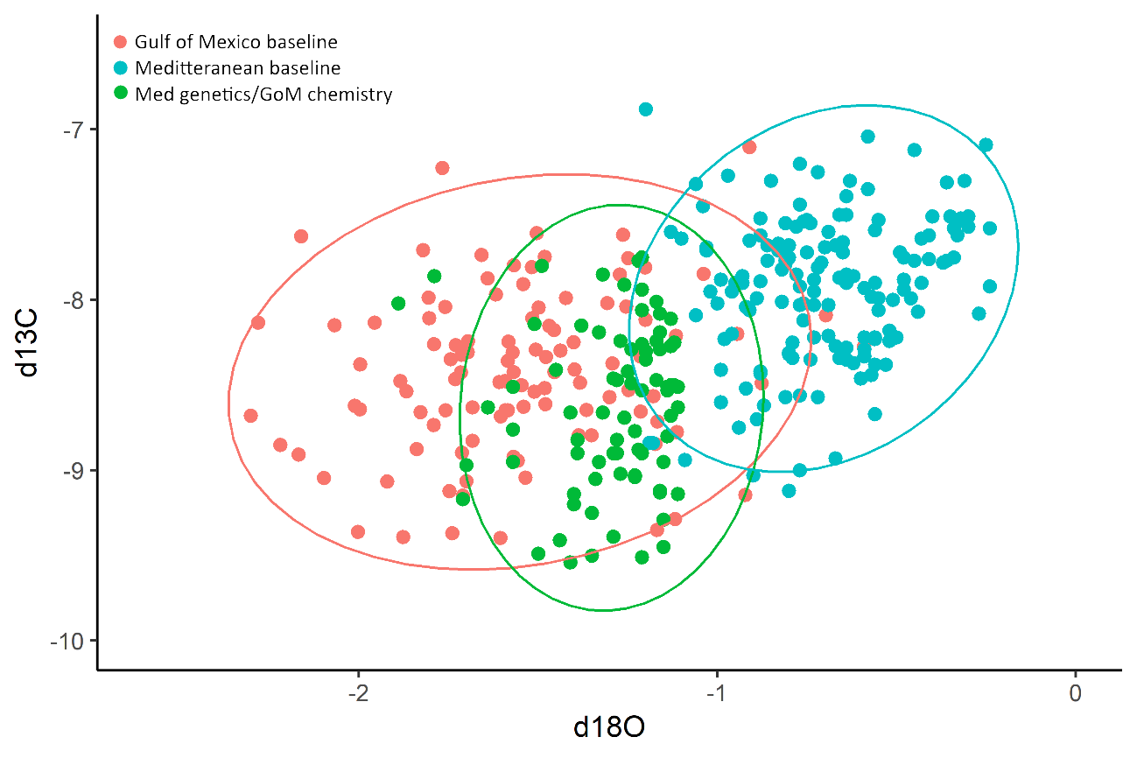
Microchemistry/Genetics
Research Programs - GBYP
Otolith Microchemistry
Isotope Profile
Discrepancy between the isotope and genetic profiles of some of the fish.
Interannual variability in mixing

Slide 18
Research Programs - GBYP
Proposed Activities Phase 10
Continuation of key elements related to:
Fishery independent indices:
Data recovery
Tagging:
Biological studies:
Modelling/MSE development:
Feasibility study for the application of acoustic surveys to the development and validation of fishery independent indices
Hold workshop on close-kin methodologies
Development and application of habitat models in CPUE standardization
Continue implementation of “BFT growth in farms study

Slide 19

Bluefin Tuna

Slide 20
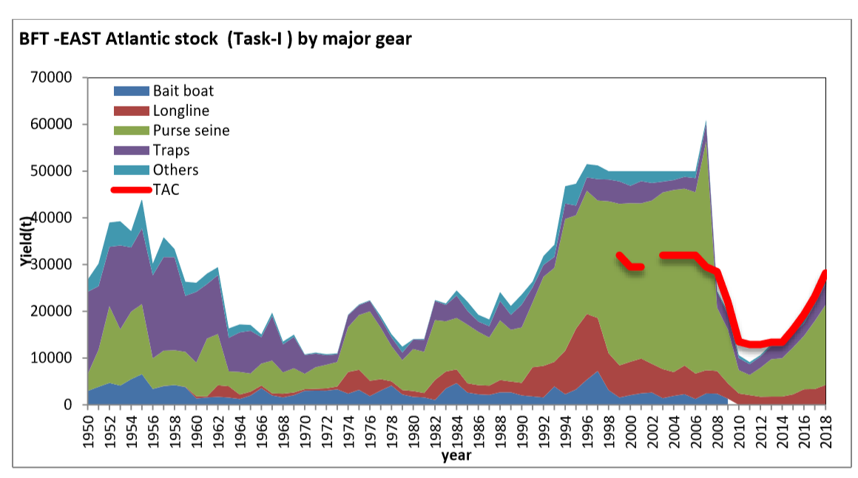
Eastern Bluefin Tuna – Fishery Indicators
Catches in the eastern Atlantic and the Mediterranean updated to 2018.
Essentially increasing since 2010 tracking the increasing TAC.
Largest increase in purse seine fleet. (9913t in 2015 to 17130t in 2018)
existence of unquantified IUU catches which needs to be quantified.

Slide 21
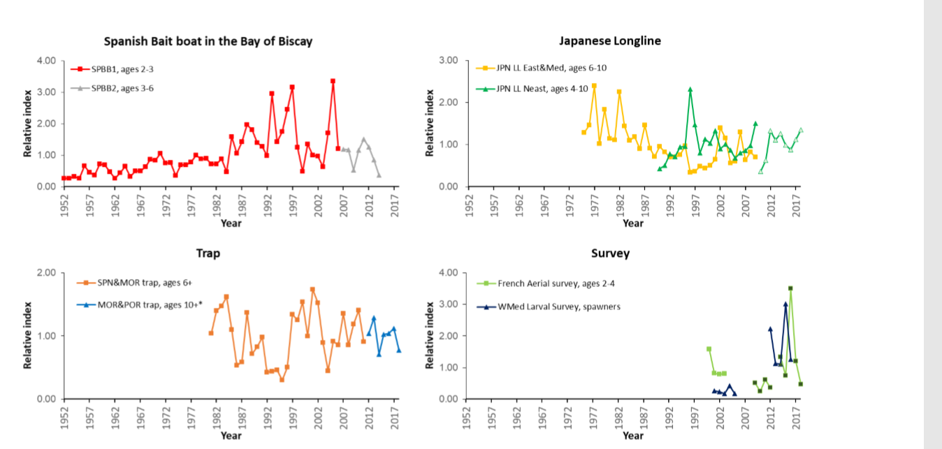
Eastern Bluefin Tuna – Fishery Indicators
ABFT_E updated fishery dependent and independent indicators

Slide 22
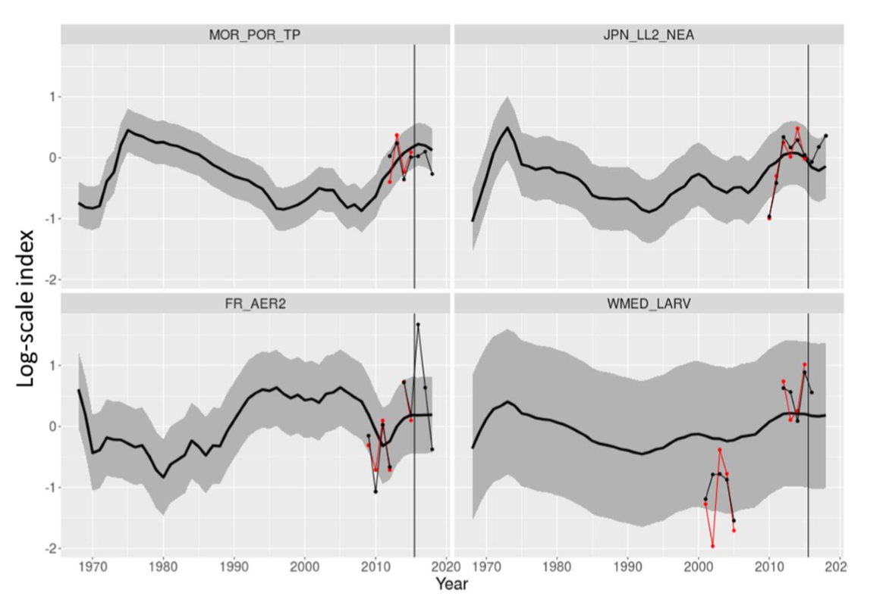
Eastern Bluefin Tuna – Fishery Indicators
Updated indices (values post 2015, vertical black line) compared with 80% prediction intervals from the 2017 VPA projected forward. 20% expected to be outside interval by random chance.

Slide 23
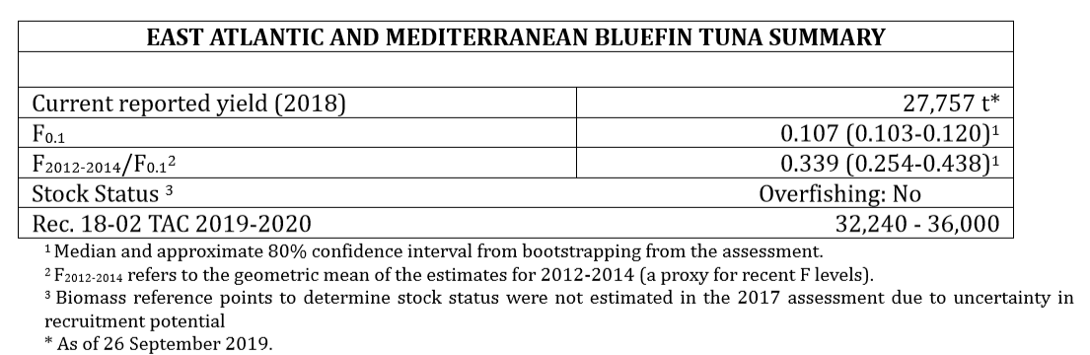
BFT E Management Recommendations
The Committee was requested to annually evaluate whether the indicators support the TACs outlined in Rec. 18-02. The fishery indicators provided did not indicate a reason to alter current management advice. Consequently, the Committee is of the view that the stepped increase for 2020 from Rec. 18-02 can be maintained.

Slide 24
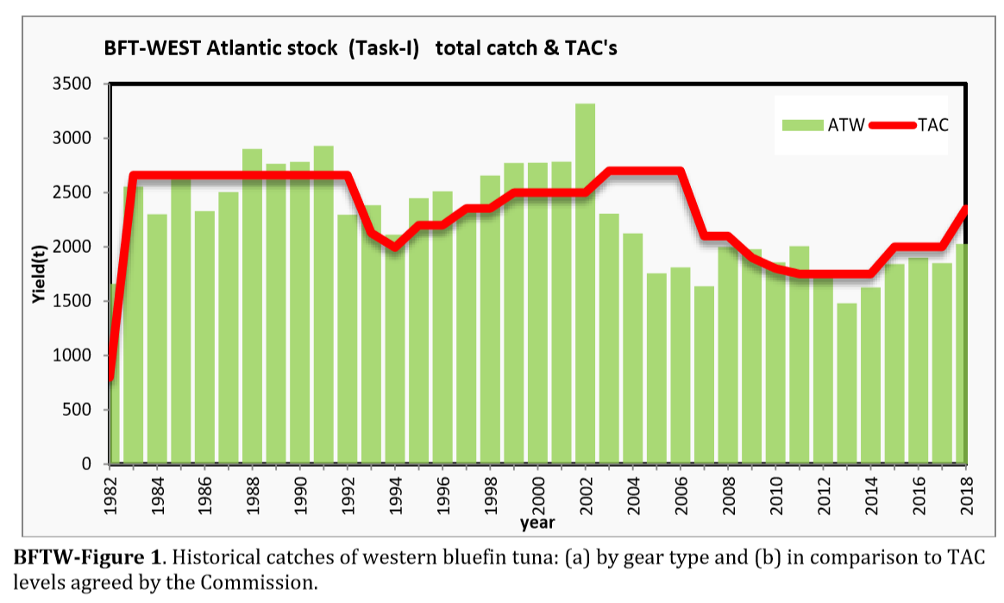
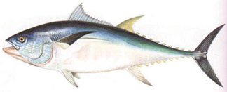
Western Bluefin Tuna – Fishery Indicators
Catches in the western Atlantic and updated to 2018.
Essentially increasing catches since 2012 tracking the increasing TAC.
Catches below TAC since 2012.

Slide 25
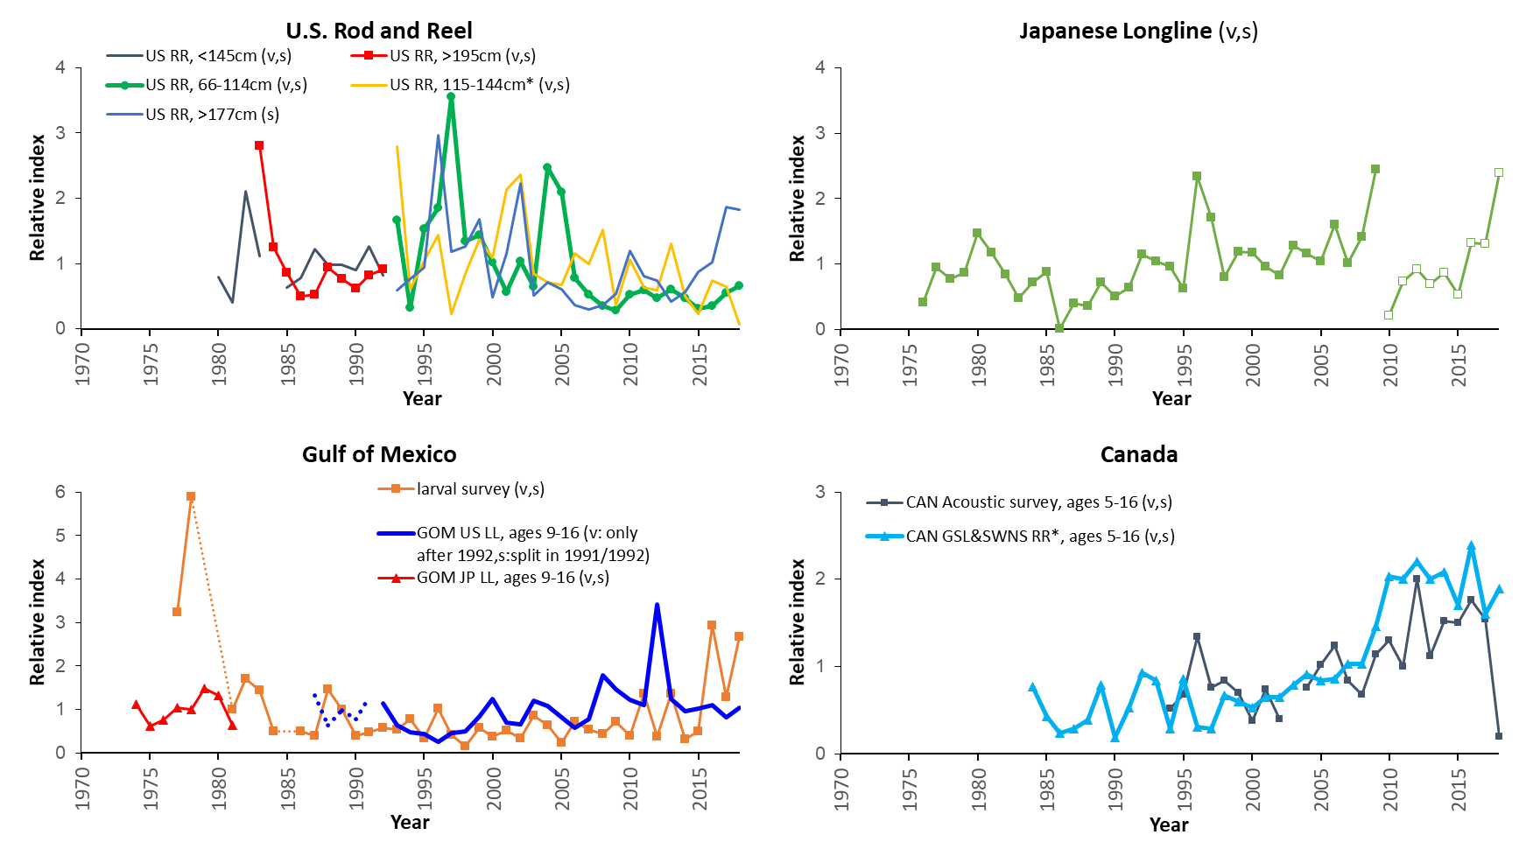
Western Bluefin Tuna – Fishery Indicators

Slide 26
Western Bluefin Tuna – Fishery Indicators
BFTW-Figure 3. Updated indices (values post 2015, vertical black line) compared with 80% prediction intervals from 2017 VPA projected with observed catches, 6-year avg. rec. & older spawning.
Red: indices used in assessment; black points are updated or revised values. Thin black lines: central tendency of population component corresponding to index.
The implications of these plots are that, by chance alone, one might expect 20% of observations to fall outside the intervals.

Slide 27
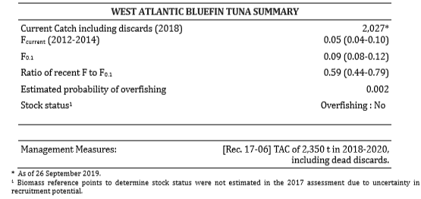
BFT W Management Recommendations
The Commission recommended (Rec. 17-06) total allowable catches (TAC) of 2,350 t in 2018, 2019 and 2020. Projections indicate that these catches would be unlikely to lead to overfishing for this three-year time period. The evaluation of the fishery indicators did not indicate a reason to alter current management advice as outlined in Rec. 17-06.

Slide 28
BFT Recommendations with financial implications
Recommendations with financial implications (SCI-067)
Continued support for essential work of GBYP for the MSE development process, biological studies, including studies related to growth in farms and the full GBYP workplan.
Two meetings devoted primarily to MSE-related work (February and July) and two BFT SG intersessional meetings (April 5-days) and 3-4 days prior to the September bluefin tuna Species Group meetings.

Slide 29
ABFT Workplan for 2020
Continue progress on MSE with four proposed meetings (2 TT , 1 BFT WG, 1 core modelers):
Conduct strict update stock assessment VPA (BFT-E and W) and Stock Synthesis (BFT-w).
BFT WG index analysts should attend WGSAM workshop focused incorporating habitat modeling and environmental considerations into CPUE standardization
Building on joint CPUE modeling meeting to develop a longline index for Gulf of Mexico between Mexico and United States.

Slide 30
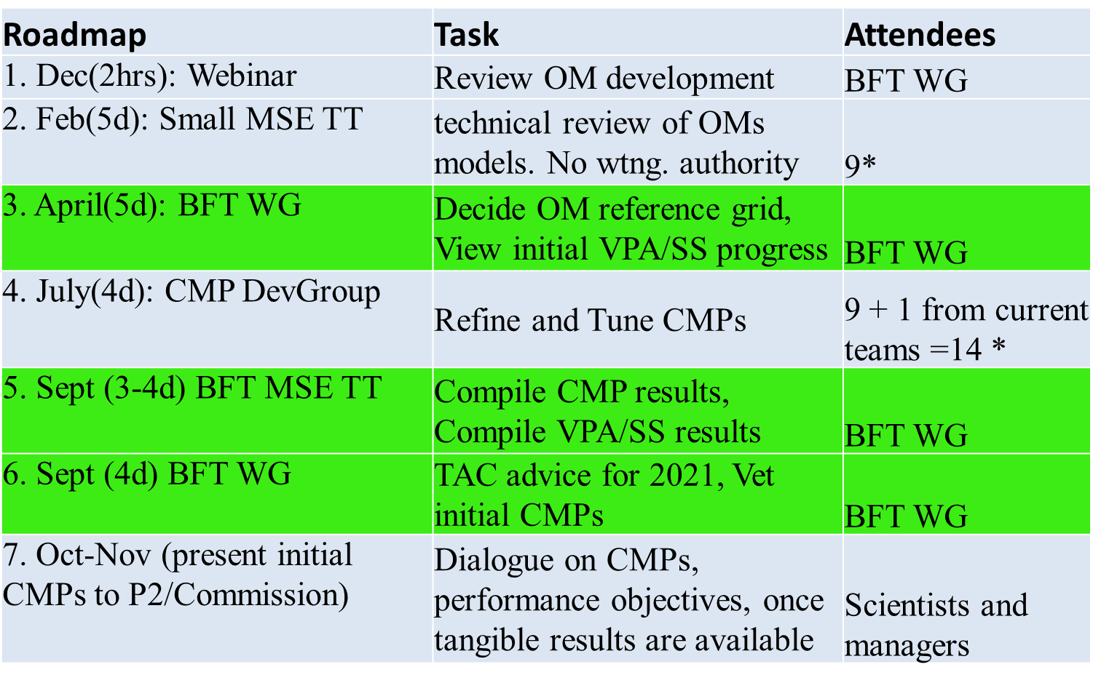
SCI_084
ABFT MSE roadmap for 2020 (SCI 084)

Slide 31

ABFT Responses to the Commission
19.1 Refine the MSE for W-BFT and continue testing the candidate management procedures. Rec. 17- 06, paragraph 16
Due to joint nature of MSE process for eastern and western bluefin tuna stocks, this response is the same as 19.2.

Slide 32
ABFT Responses to the Commission
19.2 Continue its MSE work for E-BFT, testing candidate management procedures, including harvest control rules (HCRs). Rec. 18-02, paragraph 13 . (abbreviated)
The committee is of the opinion that the MSE process is likely the best means of developing management advice robust to the complexities of bluefin tuna including stock mixing, environmental variability and other uncertainties that affect current assessment advice. Due to the complexities involved in developing operating models, the Committee has concluded that it cannot yet recommend a final reference set of operating models. Unfortunately, the MSE process will not be completed in time for the 2020 Commission meeting to provide TAC advice for 2021. Accordingly, the Committee recommends a workplan that will extend the MSE process for another year with a goal of completing the MSE process in time for the 2021 Commission meeting to provide TAC advice for 2022-2024. (Appendix 15). However, the MSE process requires sequential progress, hence completion of this plan is dependent upon achieving each step in the revised roadmap. In parallel, the Committee recommends a simple update of the stock assessment models in 2020 to provide TAC advice for 2021. Further, the committee does not perceive requiring specific input from the commission representatives and stakeholders in the form of Panel 2 and the Standing Working Group to Enhance Dialogue between Fisheries Scientists and Managers (SWGSM) for further input on the MSE until the end of 2020.

Slide 33
ABFT Responses to the Commission
19.9 The SCRS shall review and update the growth table published in 2009, and the growth rates utilized for farming the fish referred to under paragraph 35 c, and present those results to the 2020 Annual meeting of the Commission. Rec. 18-02, paragraph 28
The SCRS and some CPCs conducted or have initiated a series of studies on growth in farms. Since there are differences in the conditions and the nature of farming practices, the GBYP has initiated five growth trials in which individual fish tagging is being carried out in only two farms. Logistical and methodological issues were identified, due to the mortality generated and the uncertainty related to different behaviour of tagged fish. Due to these difficulties the Committee suggest that other methods may need to be used, knowing that in separate analyses, caging stereoscopic-camera data is being used in conjunction with harvest sample data to determine growth in fattening cages without individual fish identification. The preliminary results from some of these analyses showed different growth rates from those of the SCRS table. The Committee cannot, however, prejudge the validity of these results because of their preliminary nature.
The Table in the SCRS report describes the proposed study designs and the timeline of each individual study. The first results will be presented in 2021 and the final results by 2023.

Slide 34
ABFT Progress on MSE
Current Status
Reference set of Operating Models (OM) proposed for early 2019 still not approved due to technical issues.
  Revisions of fleet definitions and some data, necessitating re-analysis
  Selectivity mis-specifications
  Failure of the OMs to reflect seasonal variations in abundances in GOM and MED spawning areas
  Sensitivity to weightings accorded to different data types in fitting the OMs
  Coding errors
Panel 2 notified of concerns in providing MSE based TAC advise for 2021 with decision on whether to proceed to be made at July BFT TT meeting.
Due to the lack of progress the group advised the SCRS BFT working group that they should explore alternative options to provide BFT advice in for 2021 as it is unlikely to be available until 2022.
The BFT WG reviewed several options and recommends the simple update of the 2017 assessment.
    full stock assessment (alt models, model structure, data)
    simple (turn the crank) update of 2017 assessment
    Update 2017 projections w/ 2017-19 catch
    ‘Interim’ or index based approaches
    Carryover 2019 TACs (2350 and 36,000)

Slide 35
BFT/SWO MSE intersessional meeting
 | Pros | Cons | Meetings (days)
Full stock assessment* | Could account for udated indices, new data, new model structure, could account for mixing | slow, uncertainty of what may happen, will delay MSE. | 3 meetings (DP (5), AW (5), SG(4))
Turn the crank on 2017* SCRS Recommendation | Accounts for updated indices | slow, requires indices; CAA, size comp, aging data, could delay MSE | 2 meetings (1 DP(5), 1SG(4))
Update 2017 projections | Fast | no feedback from indices, or size comp, long-term projection | 2 meetings (1 DP (3), 1SG (4))
‘Interim’ or index based | Fast | requires choosing, weighting indices and tuning parameters | 2 meetings (1 DP (3), 1SG(4))
Carryover 2020 TACs (2350 and 36,000) | Fast, no meeting | risk-prone, no feedback from indices | 1 meeting (SG (4))
*options could provide for 2021-23 advice

Slide 36
ABFT workplan
SCI-058
Conduct strict update stock assessment VPA (BFT-E and W) and Stock Synthesis (BFT-w) and continue progress on MSE
Four meetings (2 ‘official’ + SCRS, 2 MSE):
BFT WG index analysts should attend WGSAM workshop focused incorporating habitat modeling and environmental considerations into CPUE standardization
Building on joint CPUE modeling meeting to develop a longline index for Gulf of Mexico between Mexico and United States.

Slide 37
ABFT workplan
SCI-086
Specifications for 2020 BFT stock assessment to give 2021 TAC advice
Strict update of 2017 VPA (E and W) and SS (W) updated to 2018
Same indices, we have now to 2018 (except MedLarval index to 2017 & CanAcoustic index 2018 is being checked)
Same
  methods for CAS/CAA
  parameter settings but re-estimate values for estimated parms
  biological assumptions (old/young spawn for West, M, etc)

Slide 38
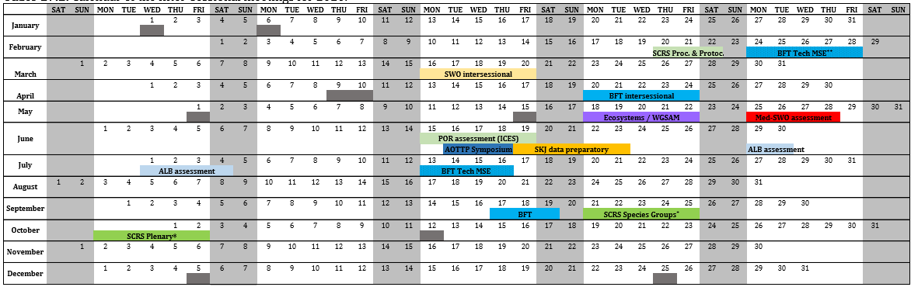
Calendar for 2020
Inter-sessional SCRS meetings 2020
Assessments: MED _SWO, ALB, BFT TT
New : SCRS Procedures and Protocols

Slide 39
Insert Calendar for activities.

Slide 40
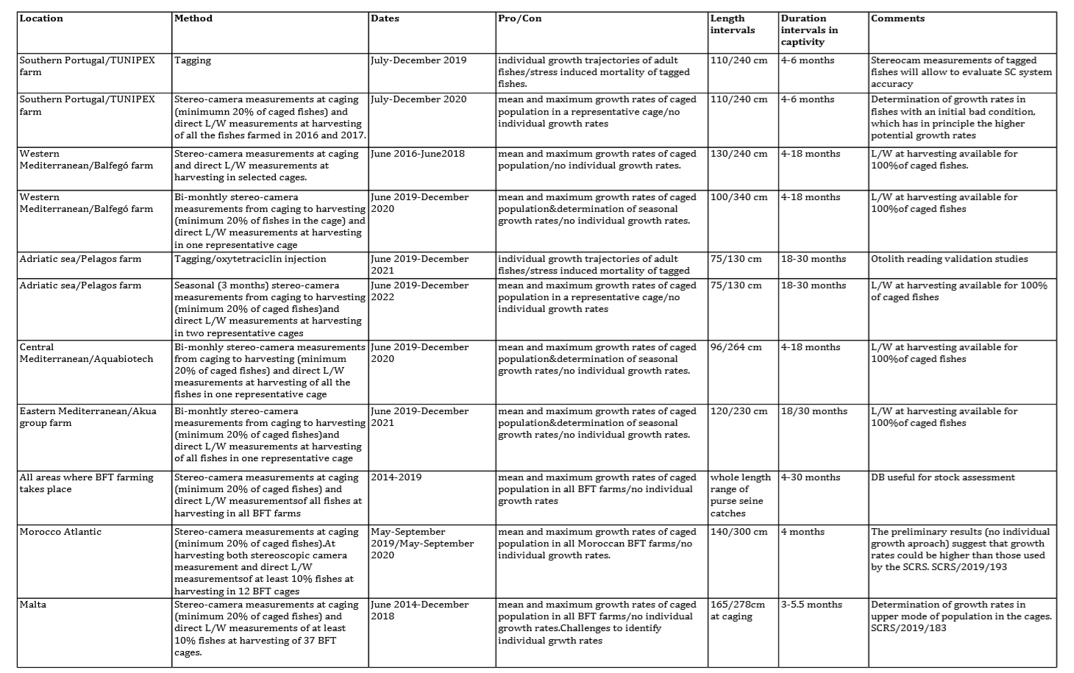
Growth Studies

Slide 41
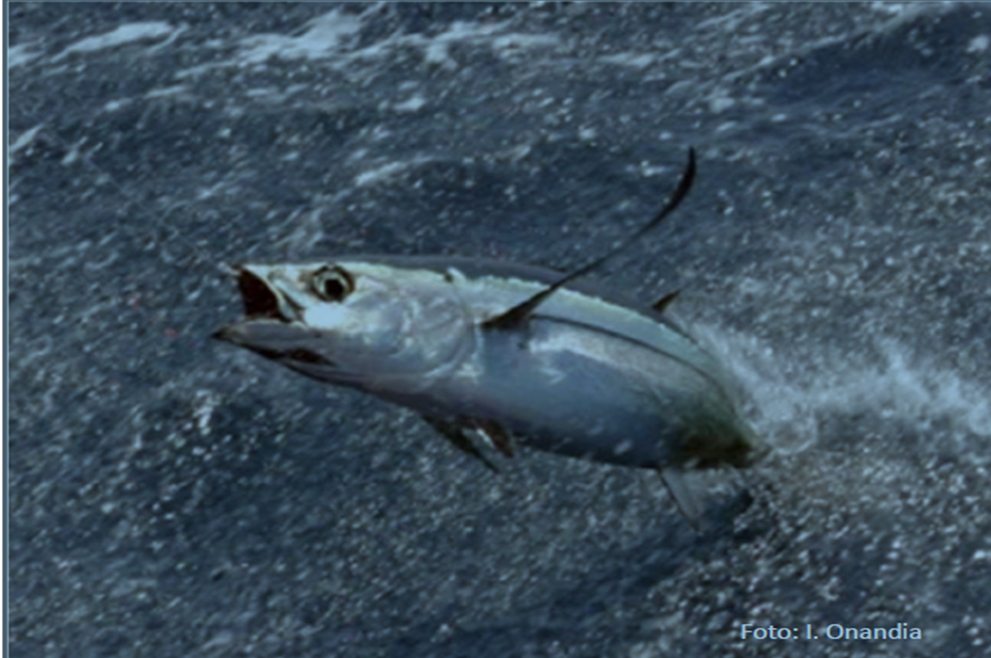
Summary Northern Temperate Tunas
Northern Temperate Tunas
  Albacore -2 Stocks
    North (2014) and Med (2015)
    Next stock assessment 2020
  Bluefin Tuna 2 stocks
    Eastern and western (2017)
    Next stock assessment in 2020

Slide 42
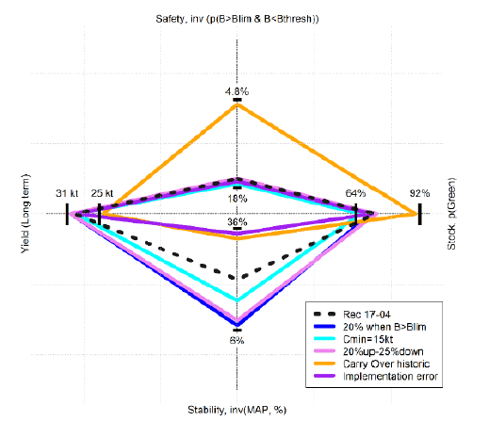
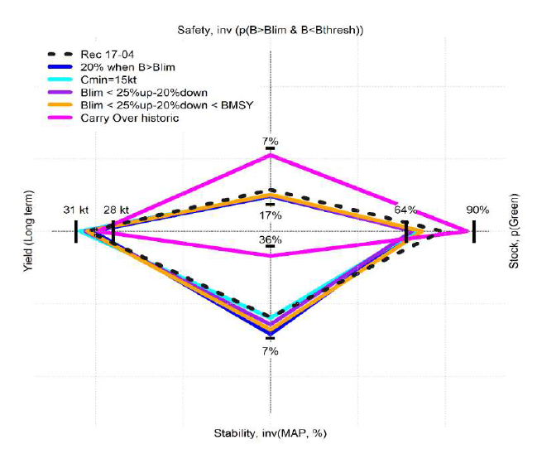
Executive Summary- Albacore
Spider plots representing the relative performance of the HCR adopted in Rec 17-04,
- Updated in 2019 alternative HCR
2018
2019

Slide 43
Phase 8 and 9 time frame and budget
Phase 8 (21 February 2018 - 20 September 2019)
6 months extension needed for better addressing the current research needs (new study on bluefin growth in farms initiated).
Phase 9 (1 January 2019 – 31 December 2019)
will be possibly extended
 | Phase 8 | Phase 9
Coordination | 312,500.00 € | 285,000.00 €
Data Recovery | 58,000.00 € | 20,000.00 €
Independent Indices | 494,500.00 € | 512,000.00 €
Biological Studies | 583,000.00 € | 585,000.00 €
Tagging | 159,000.00 € | 208,000.00 €
Modelling | 143,000.00 € | 140,000.00 €
FINAL | 1,750,000.00 € | 1,750,000.00 €
Approved budget

Slide 44
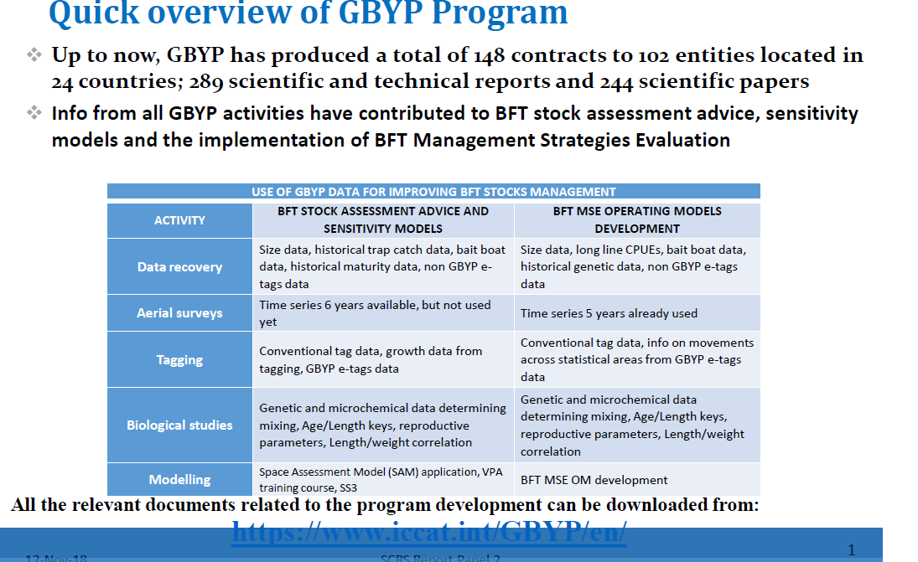
GBYP Program

Slide 45
Research Programs - GBYP
GBYP Coordination Phases 8 & 9
  4 Steering Committee Meetings
  40 contracts signed to undertake activities
  3 workshops (reproduction, growth and e-tags deployment methodologies)
  Phase 8 final report submission
Catch data
  Ancient traps data recovery (5 Italian traps; XVIII-XX century)
  Recent catch data (ICES reports 1962-1978)
Electronic tags datasets
  41 electronic tags deployed in 2016-2017 off Canada and in 2017 off Ireland
  220 electronic tags deployed in Western Atlantic from 2002 to 2009

Slide 46
MSE
Research Programs - GBYP
Phase 10
Continuation of key elements related to:
Fishery independent indices:
Data recovery
Tagging:
Biological studies:
Modelling:
Feasibility study for the application of acoustic surveys to the development and validation of fishery independent indices
Hold workshop on close-kin methodologies
Development and application of habitat models in CPUE standardization
Continue implementation of “BFT growth in farms study
Funding for MSE development expert.
Support for BFT MSE Technical Group, funding the attendance of Chair, contracted expert and several members of the group to relevant meetings.
Meetings supported in 2019:
  MSE BFT Technical Group meetings held in Madrid in February 2019,
  MSE BFT Technical Group meetings held in Saint Andrews in July 2019 and,
  MSE BFT Technical Group meetings held at ICCAT headquarters in September 2019.

Slide 47
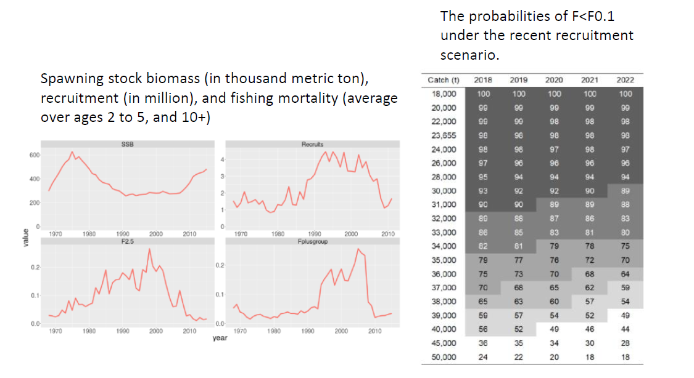
BFT E State of Stock and Outlook

Slide 48
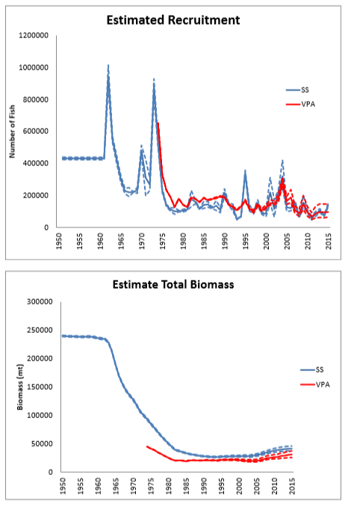
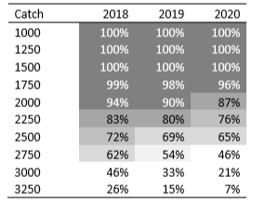
Western Bluefin Tuna –State of Stock and Outlook
Kobe II matrix giving the probability
that overfishing not occurring (F≤F0.1)
From 2017 stock assessment

Slide 49
ABFT Progress on MSE
BFT MSE Background
BFT MSE Process began in 2015 (Rec 15-07), although work was conducted prior
Between 2016 and 2017 there were a number meetings to discuss approach and Develop the MSE framework.
    5 Core Modelling group
    Joint tRFMO MSE Meetings
    Intersessional meetings, and
    Science and Managers dialogue.
Originally schedule anticipated MSE framework providing interim BFT advice for 2020.
Delayed due to requirement to conduct full assessment in 2017 and other issues.
2018 April MSE-BFT Meeting (Madeira), recognized complexity of process and SCRS recommended to the Commission a more realistic schedule for completing the MSE.
Schedule revised to provide interim BFT advice for 2021.
Unfortunately, Based on 2019 BFT TT and Intersessional this date will have to be revised again to 2022.

Slide 50
ABFT workplan
SCI-086
Specifications for 2020 BFT stock assessment to give 2021 TAC advice
Strict update of 2017 VPA (E and W) and SS (W) updated to 2018
Same indices, we have now to 2018 (except MedLarval index to 2017 & CanAcoustic index 2018 is being checked)
Same
  methods for CAS/CAA
  parameter settings but re-estimate values for estimated parms
  biological assumptions (old/young spawn for West, M, etc)
Time line:
1. Jan 15th 2020: (2017 larval index due)
2. March 15th 2020: CAS and aging data (otoliths, spines due)
3. April 2020, BFT WG: First progress update
4. Sept 2020, BFT WG: completed report, projections and Kobe table

